Slide 1
Apache Ignite as Kubernetes Store

Slide 2
Problem
No horizontal scalability: adding more etcd nodes does not improve latency
Native etcd “freezes” when there are 15K+ pods in Kubernetes cluster
Native etcd is highly available but not scalable
Only expensive vertical scalability is possible

Slide 3
Solution
Apache Ignite is horizontally scalable distributed database
Ignite-Etcd: shim layer converting Etcd API to Ignite API
Horizontal scaling solves the problem

Slide 4
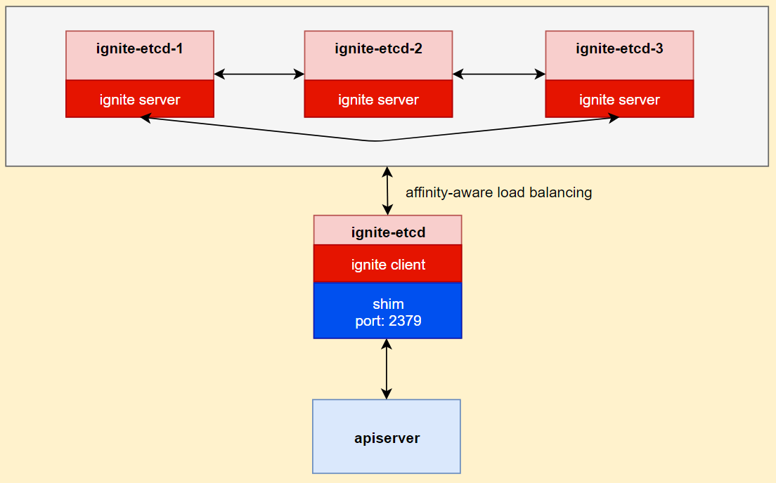
Architecture
ignite-etcd is a standalone POD
Shim layer converts Etcd to Ignite API
Ignite Client node communicates with Ignite cluster
Data and workload scale
Most efficient affinity-aware Ignite load balancing

Slide 5
Full Functional Compatibility
Etcd contract fully implemented
KV (range, put, delete, transaction)
Watch
Lease (grant, revoke, keep alive)
Cluster (list, add, remove nodes)
Authentication (list, add, remove users)
Maintenance (status, snapshots)
Health (check)
All Kubernetes integration tests PASS (see the report)

Slide 6
Security
Apiserver - Ignite-etcd connection secured with HTTPS
ignite-etcd --cert-file=ignite-etcd.crt --key-file=ignite-etcd.key
kube-apisever --etcd-cafile public.crt
Connections between Ignite nodes secured with SSL/TLS
Additional Transparent data encryption (TDE) is available in Ignite

Slide 7
Metrics
Full etcd metrics compatibility (see the metrics list)
HTTP /metrics endpoint provides metrics in Prometheus format

Slide 8
Performance & Throughput
TODO: Kubemark density and load tests with 15K pods PASS (see the report)

Slide 9
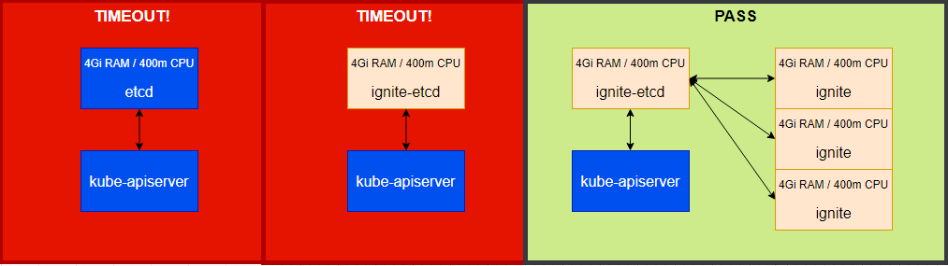
Horizontal Scalability: Kubemark Density Tests
See report See report See report
Native etcd limited with 4Gi/400m resources fails
3-nodes of the same size Ignite-etcd passes

Slide 10
TODO: Costs

